Slide 1
Interactive Space Hub
Aisultanova Nazym
4240-kzh
Amit Joshi

Slide 2
The Assessment Creation Challenge
Learning astronomy should feel like exploring space —
but most assessments feel like reading a manual.
Students struggle to imagine how planets move,
how far they are from the Sun,
and how space actually works.
Static text and simple quizzes fail to inspire curiosity
and limit real understanding of space science.

Slide 3
The Cost of Manual Assessment Creation
Behind every traditional assessment is a long and tiring process.
Educators manually create content,update questions,check answers,
and repeat the process again and again.In a fast-changing field like space science,
this approach wastes time, energy, and resources.

Slide 4
Our Solution: Interactive Space Hub
1.Interactive Space Hub transforms learning into exploration.
2.Instead of reading about planets,users see them move.
3.Instead of memorizing facts,they interact, discover, and test knowledge.
4.All learning tools are combined into one powerful web application

Slide 5
How It Works
The journey starts on a single dashboard.
Users explore animated planetary orbits,click planets to reveal scientific facts,ead real-time space news,and test their knowledge through quizzes.
Learning becomes a smooth, logical flow —from curiosity to understanding

Slide 6
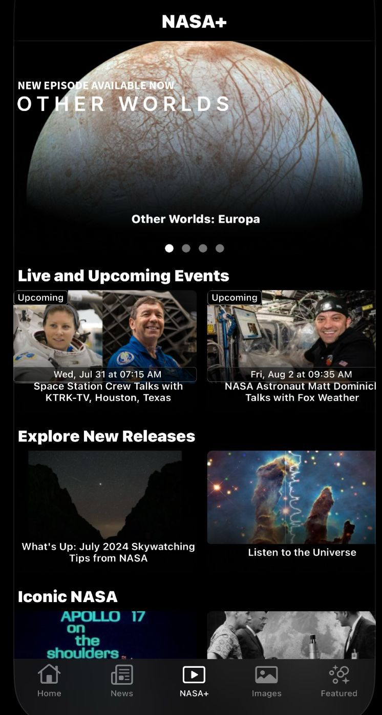
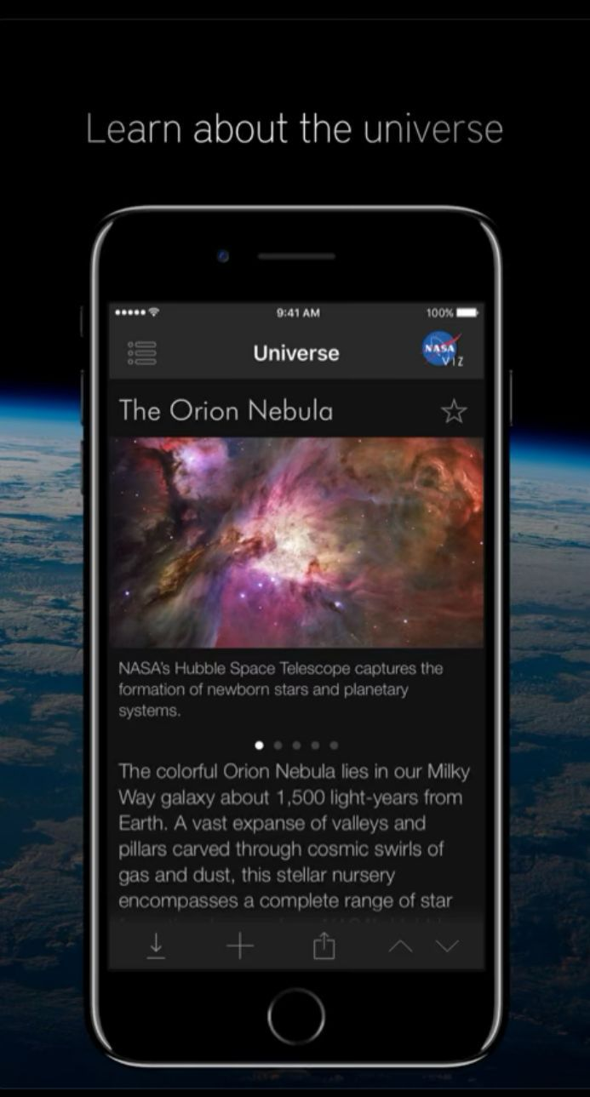
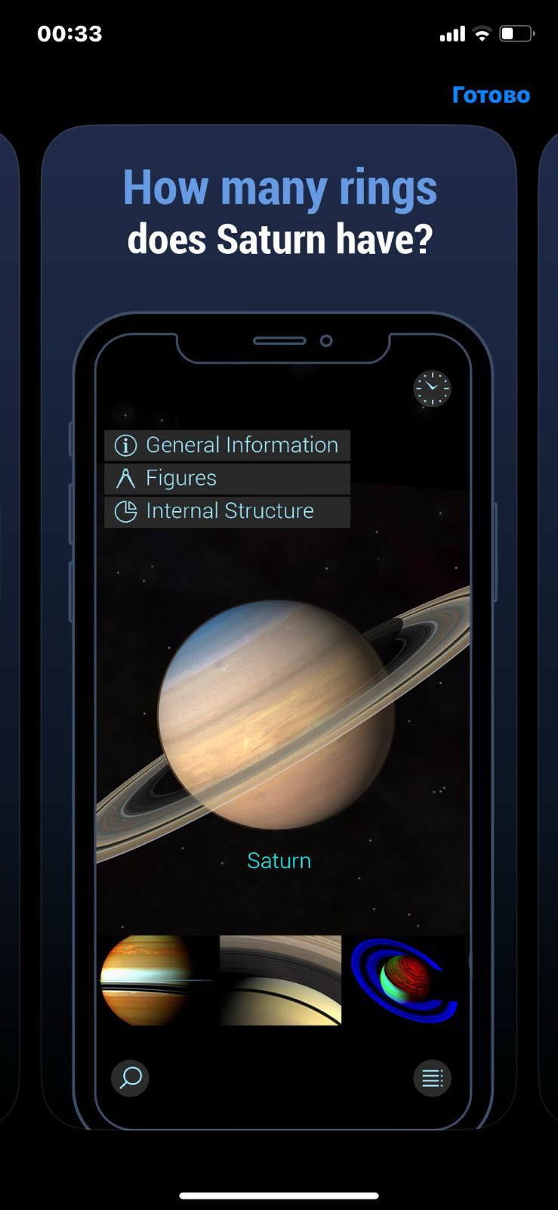
xx%
Доб

Slide 7
Powerful Features That Save Time
Smart automation replaces manual work.
Quizzes check themselves.
News updates automatically.
Simulations explain complex ideas instantly.
This saves time for educators
and creates a richer learning experience for users.

Slide 8
Built with Modern Technology
Interactive Space Hub is powered by modern web technologies.
HTML and CSS shape the interface,
JavaScript brings motion and logic to life,
APIs connect the app to real space data.
Optional 3D tools turn science into an immersive experience.

